Slide 1

New Covid-19 Updates for Manufacturers – OR OSHA Temporary Standards & CDC Close Contact Definition
PRESENTED BY
Joshua Dennis
Jean Ohman Back
November 10, 2020

Slide 2


HOW DID WE GET HERE AND WHERE ARE WE GOING?
Federal OSHA Guidance
Enforcement under General Duty Clause
Complaints (by Oct. 12, 2020, Oregon OSHA received 11,000 complaints related to COVID-19)
Four drafts of the Temporary Standards
Temporary Standards Adopted—in effect for 180 days
Oregon OSHA has begun working on permanent infectious disease rules

Slide 3

WhoM do these rules apply to?
Everybody (in Oregon)!
“All workplaces and workers subject to Oregon OSHA’s jurisdiction”
Am I covered by Oregon OSHA’s jurisdiction?

Slide 4

Which rules apply to my company?
Broken down into two sections:
Everybody except “workplaces at exceptional risk”; and
Workplaces at exceptional risk.
How do I know if my workplace is at exceptional risk?

Slide 5

Requirements: Physical distancing
All employers must ensure that both work activities and workflow are designed to eliminate the need for any employee to be within 6 feet of another individual in order to fulfill their job duties unless the employer determines and can demonstrate that such physical distancing is not feasible for certain activities.

Slide 6

Requirements: Masks, face coverings, or face shields
Each employer must ensure that all individuals at the workplace or other premises subject to the employer’s control wear a mask, face covering, or face shield.
Must be provided at no cost to employee
What if an employee refuses to wear a mask? Is medically exempt from wearing a mask?
Exception to rule: At all times indoors, unless employee is at a private, individual workspace not shared with other people.
What about outdoors? Or in a vehicle?
Other exceptions…

Slide 7
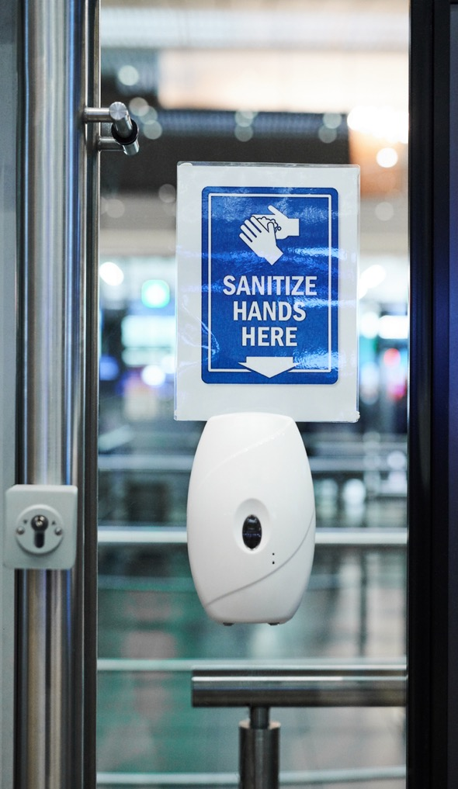
Requirements: Sanitation
The employer must regularly clean or sanitize all common areas, shared equipment, and high-touch surfaces that are under its control and that are used by employees or the public.
How often should employers be sanitizing these areas?
How do you sanitize an area where an employee who tested positive worked?

Slide 8

Requirements: Posting
The “COVID-19 Hazards Poster” must be permanently posted in a conspicuous manner in a central location where workers can be expected to see it.
Where do I get this poster? What about employees who work remotely?

Slide 9
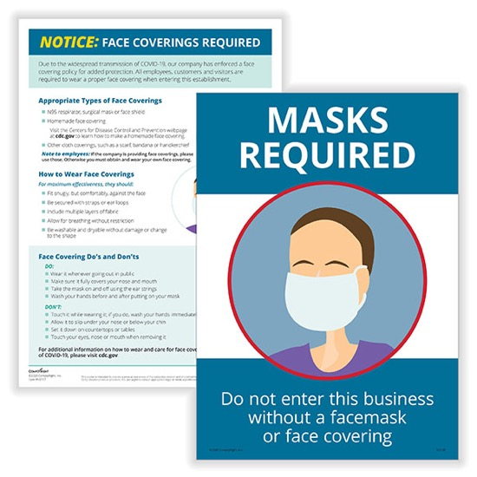

Requirements: Building Operators
Within 17 days after adoption of the rules, employers who operate or otherwise control buildings where the employees of other employers work must: (1) ensure that the sanitation requirements are met; and (2) post signs in areas where masks, face coverings, or face shields are required.

Slide 10
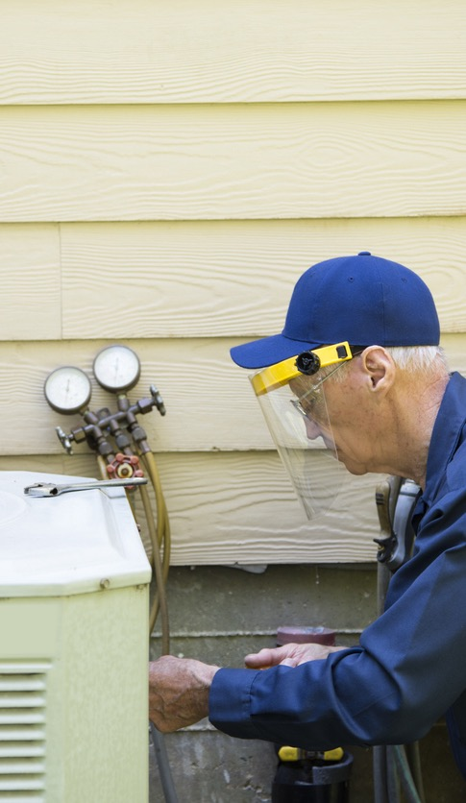


Requirements: ventilation
Within two months after adoption of the rules, an employer must maximize the amount of outside air circulated through its existing HVAC system(s), to the extent the system is capable of doing so, whenever there are employees in the workplace.
Do I need to install an HVAC system or upgrade my existing HVAC system?
Additional HVAC
maintenance
requirements?

Slide 11
Requirements: Exposure Risk Assessment
Who? All employers
What? A COVID-19 exposure risk assessment, without regard to the use of personal protective equipment, masks, face coverings, or face shields.
When? No later than one month after the adoption of the rules.
Where? If an employer has multiple facilities that are substantially similar, its assessment may be developed by facility type rather than site-by-site so long as any site specific information that affects employee exposure risk to COVID-19 is included in the assessment.
How? Write it down if more than 10 employees statewide.
What? Lots of questions to ask as part of assessment, but an answer does not always trigger a new requirement.

Slide 12
Requirements: Infection Control plan
Who? All employers.
What? Establish and implement an infection control plan.
When? No later than one month after the adoption of the rules.
Where? If multiple facilities that are substantially similar, the infection control plan may be developed by facility type rather than site-by-site so long as any site-specific information that affects employee exposure risk to COVID-19 is included in the plan.
How? Write it down if more than 10 employees statewide and make it accessible.
What? Rules provide minimum elements of infection control plan.

Slide 13

Requirements: employee information and training
No later than six weeks after the adoption of the rules, employers must provide workers with information and training regarding COVID-19.
Must provide opportunity for feedback.
Training must include:
    Masks, face covering, face shields;
    Physical distancing;
    Sanitation;
    Reporting procedures;
    Infection notification process;
    Medical removal;
    Methods of transmission;
    Symptoms;
    Safe and healthy work practices.

Slide 14
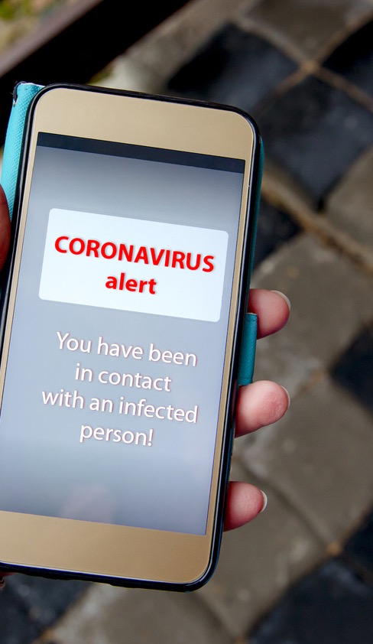
REQUIREMENTS: infection notification process
Employer must establish a process to notify affected employees that they had a work-related contact with an individual who has tested positive for COVID-19.
How soon should employees be notified?

Slide 15
REQUIREMENTS: TESTING
Employer must cooperate by making its employees and appropriate space available at no cost to the workers whenever a local public health agency or OHA indicate that COVID-19 diagnostic testing within the workplace is necessary.
If testing is conducted at employer’s own direction, employer is responsible for the costs of testing, employee time, and employee travel.
What about testing not at employer’s direction?

Slide 16
REQUIREMENTS: MEDICAL REMOVAL
Whenever the OHA, a local public health agency, or a medical provider recommend an employee be restricted from work due to quarantine or isolation for COVID-19, the affected worker must be directed to isolate at home and away from other non-quarantined individuals.
Are you required to allow quarantined employee to work from home?
Are employers required to hold the job for the person who needed to quarantine?
How do you decide whether to allow a person to return to work? Is a negative test required?
When should a COVID-19 event be recorded on the OSHA 300 log?

Slide 17
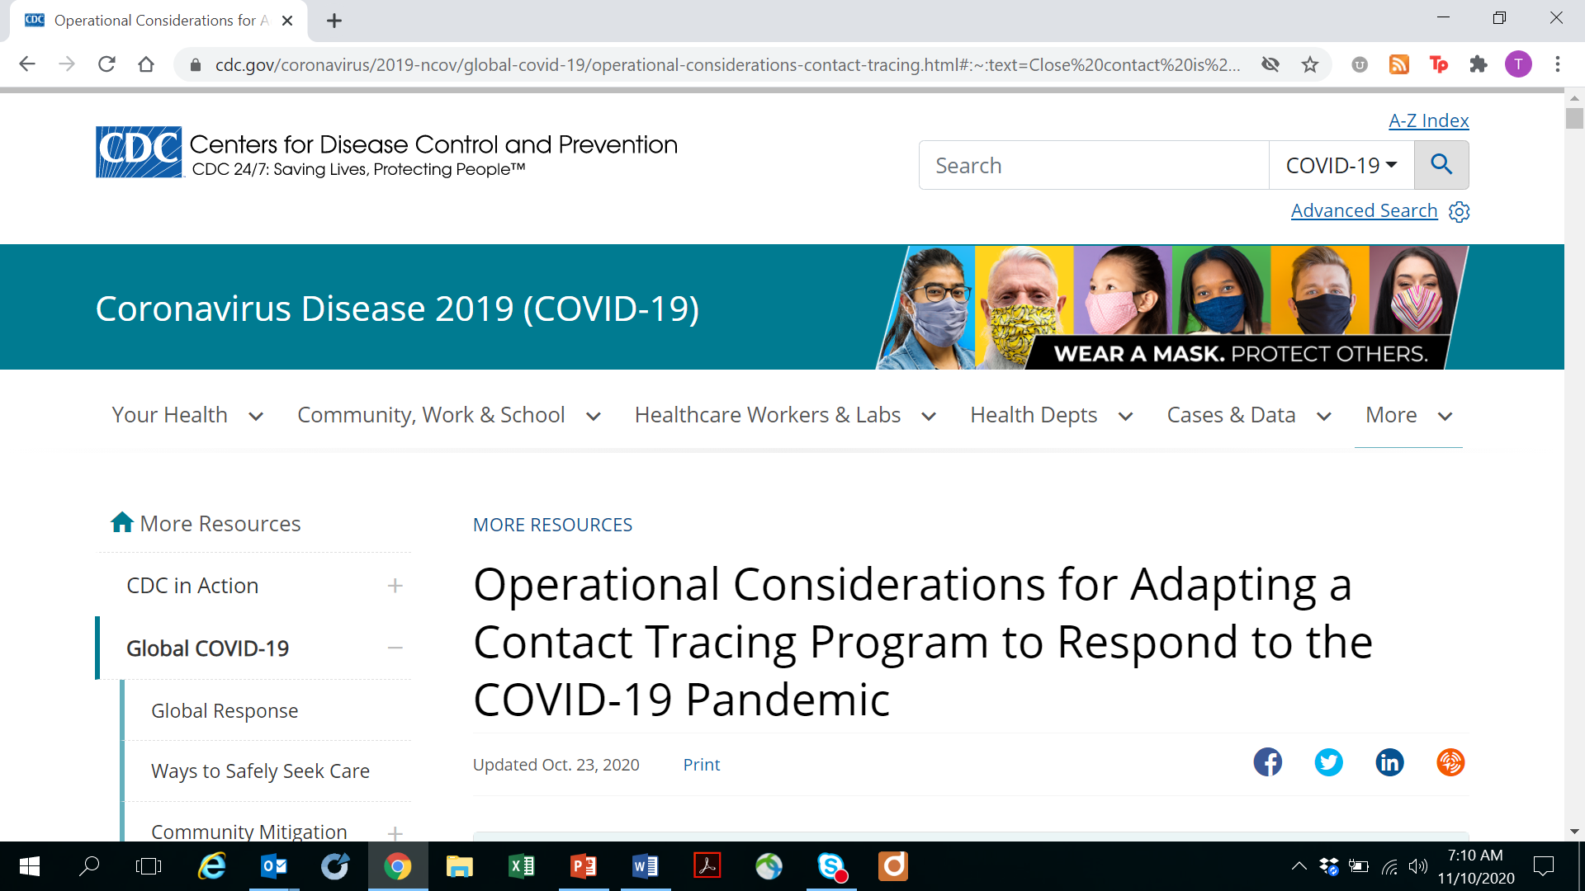
New CDC Close contact Definition

Slide 18
New definition of close contact
“Someone who was within 6 feet of an infected person for a cumulative total of 15 minutes or more over a 24-hour period starting from 2 days before illness onset (or, for asymptomatic patients, 2 days prior to test specimen collection) until the time the patient is isolated.”

Slide 19

Cumulative exposure
The CDC and Oregon look at “individual exposures” added together over a 24-hour period.
For example three 5-minute exposures over a total of 15 minutes

Slide 20
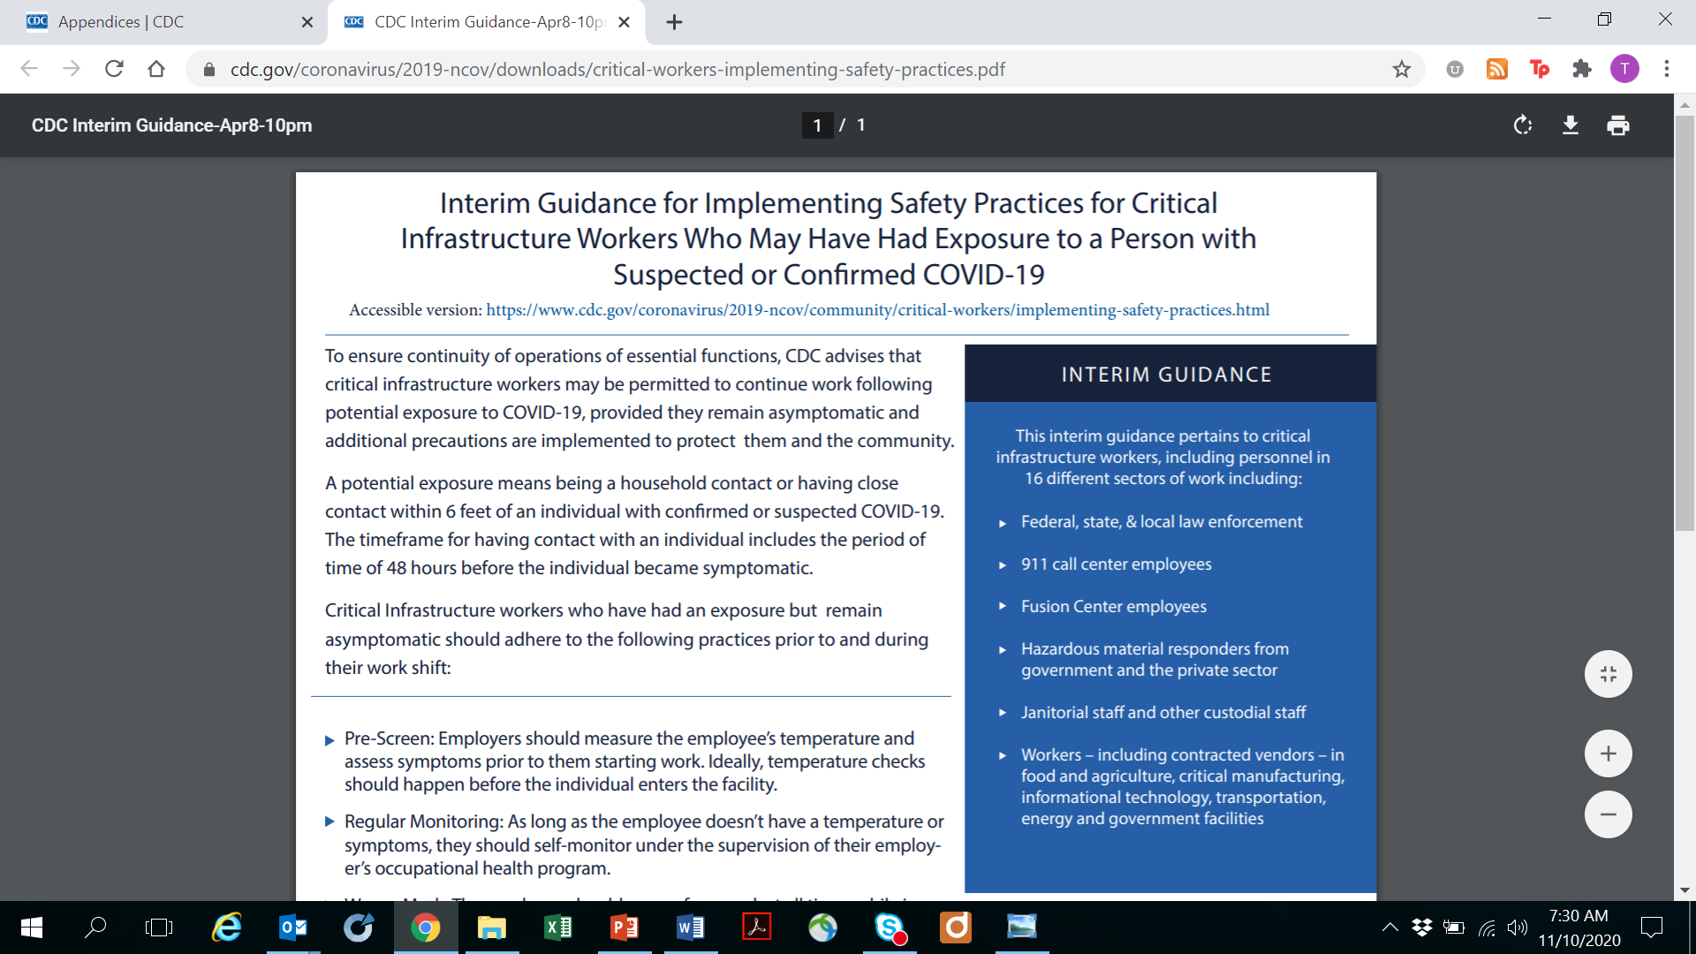
Critical infrastructure exceptions

Slide 21
Quarantine Requirements
Critical infrastructure workers may be permitted to continue work following potential exposure to COVID-19, provided they remain asymptomatic and additional precautions are implemented to protect them and the community.
A potential exposure means being a household contact or having close contact within 6 feet of an individual with confirmed or suspected COVID-19 for a period of 48 hours before the individual became symptomatic.

Slide 22
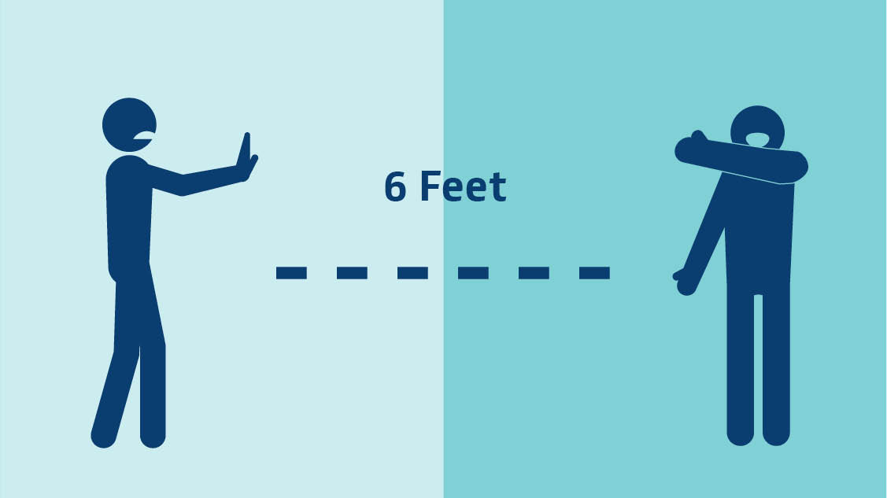
Precautions are not new
Prescreen – monitor temps
Regular self monitoring
Wear a mask
Social distance
Sanitize

Slide 23

Josh Dennis
Associate
503-796-2985‎ Direct
jdennis@schwabe.com
“I Understanding your client’s business is key to being an ‎effective advocate.‎”
^{industry focus}
Josh Dennis advises construction companies of all sizes through the many stages of the litigation process. Josh also has extensive experience representing employers through inspections and litigation arising out of state and federal OSHA enforcement actions. Josh takes pride in his ability to add value to his clients’ businesses by seeking out creative and cost-effective solutions to otherwise complex problems.
Real Estate & Construction

Slide 24


“Not every engagement requires the same solution. Creativity, collaboration, resourcefulness, and excellent listening skills can often lead to unique and successful business solutions.”
Jean Back
Shareholder
503-796-2960 Direct
Jback@schwabe.com
Jean Back brings more than 25 years of experience in helping manufacturers and technology-focused employers solve problems to complicated employment scenarios. She has broad expertise in litigation, mediation and settlement of employment and business tort claims. She is fluent in all areas of state and federal employment, wage and hour, discrimination, and leave laws. She is skilled at training managers and employees in employment compliance.
^{Industry focus}
Manufacturing,
Distribution and Retail
Technology

Slide 25






Natural
Resources
Real Estate
& Construction
Healthcare &
Life Sciences
Manufacturing,
Distribution
& Retail
Transportation,
Ports & Maritime
Technology

